Slide 1

Arduino for Neuroscientists NBHVGR7040
AfN #2: More complex Inputs and Outputs

Slide 2
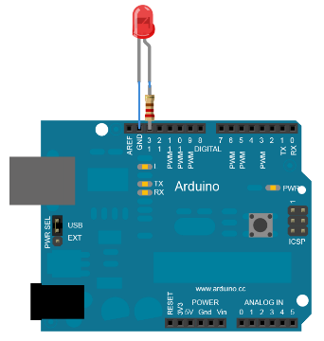
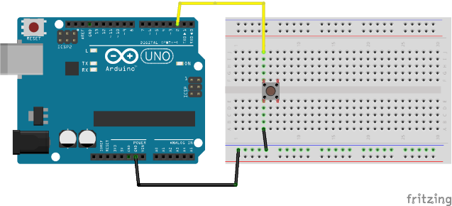
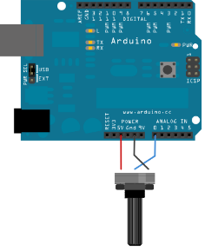
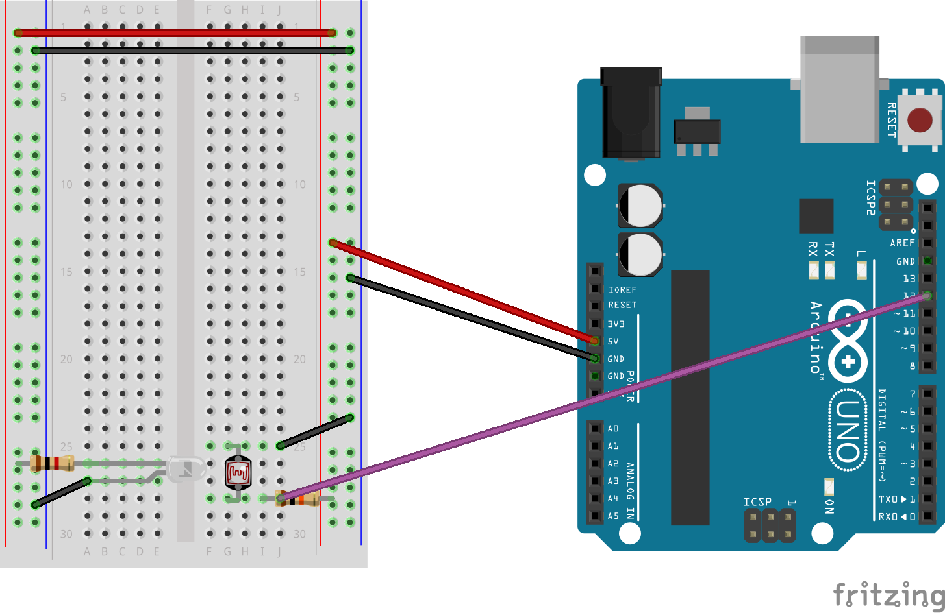
Last time:
Simple Input/Output (“IO”)
Digital output: Blink
pinMode(pin, OUTPUT);
digitalWrite(pin, HIGH/LOW);
0V/+5V
Digital input: button
pinMode(pin, INPUT/INPUT_PULLUP);
Val = digitalRead(pin);
NOTE: debouncing
Analog input: pot/IR
0-5V > 0-1023
No pin setup needed
Val = analogRead(pin);

Slide 3
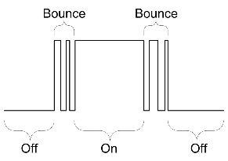
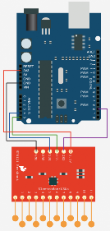
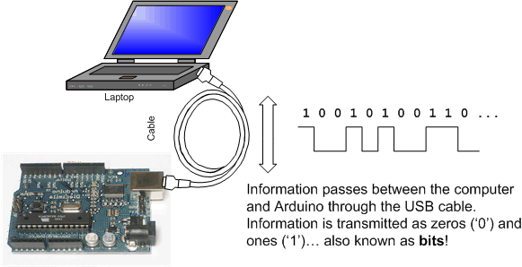
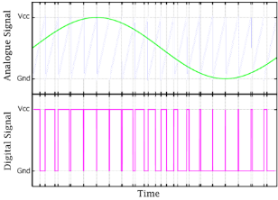
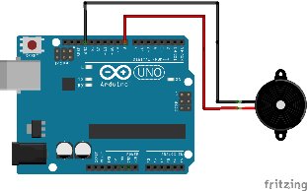
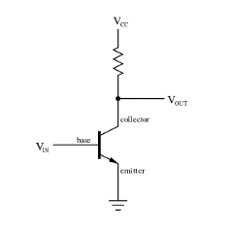
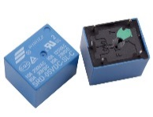
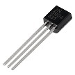
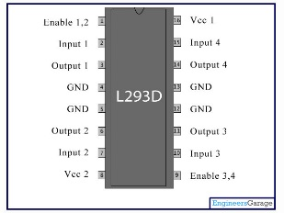
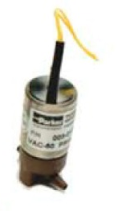
This week:
More complex Input/Output (“IO”)
“Debouncing” inputs
Digital communication protocols
Serial
I2C/SPI
Analog output
Pulse-width modulation (PWM)
analogWrite(pwmPin, freq.);
tone(pin, freq., dur.);
Digital output
Getting around the 0/+5V limit
Relays
Transistors
H-bridges
Solenoid valves

Slide 4
A few additional notes before we begin
Code:
Integer types:
int var=-32,768:32,767; (i.e. max ~33sec in millis, 2^16, 16bit)
unsigned int var=0-65,535; (i.e. max ~66sec in millis)
long var=-2,147,483,648:2,147,483,647; (max ~600hr, 32bit)
unsigned long var=0-4,294,967,295; (max ~1200hr, 50days!)
Electronics:
Ground everything together
Then everything agrees on GND voltage
In setup(): randomSeed(floatingAnalogPin);

Slide 5
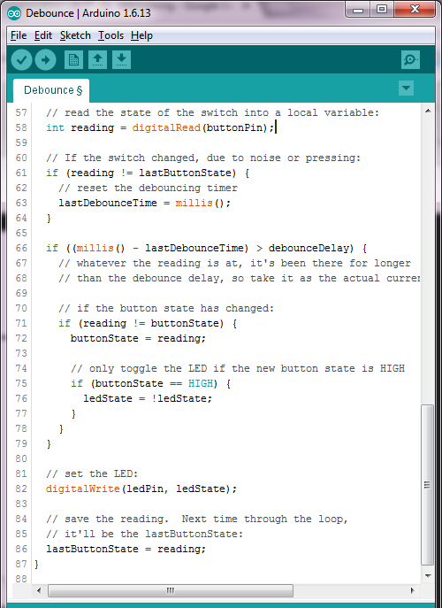
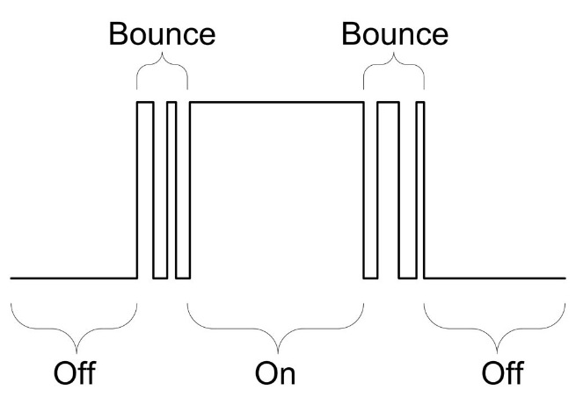
“Debouncing” inputs
Simple thresholds may lead to spurious activations, due to sensor, environmental, or behavioral noise (voltage spikes, ambient light level changes, accidental animal contacts)
Thus “debouncing” in code sets a more stringent threshold, based upon the history of the input
Examples:
Integrating signal over time
Look for signal changes over local/recent baseline
Notes:
Go through debounce example code to learn how to think through arduino flow logic

Slide 6

Inputs and Outputs: sensory and motors systems
Inputs: analog and digital
Outputs: digital
Primary limitation!: Arduino can only output 0/+5V
PWM: to approximate analog output
Working with larger and negative voltages
Relays
Transistors
H-bridges
Digital communication protocols
Serial
I2C/SPI
Digital input/outputs
Serial RX/TX
Analog inputs

Slide 7
Digital Communication protocols: Serial
Start in setup(), Serial.begin(baudRate);
RX=receive, TX=transmit
Buffered (i.e. can send/receive even when other stuff is going on)
But can have bottleneck (1ms/char?)
Send short messages

Slide 8
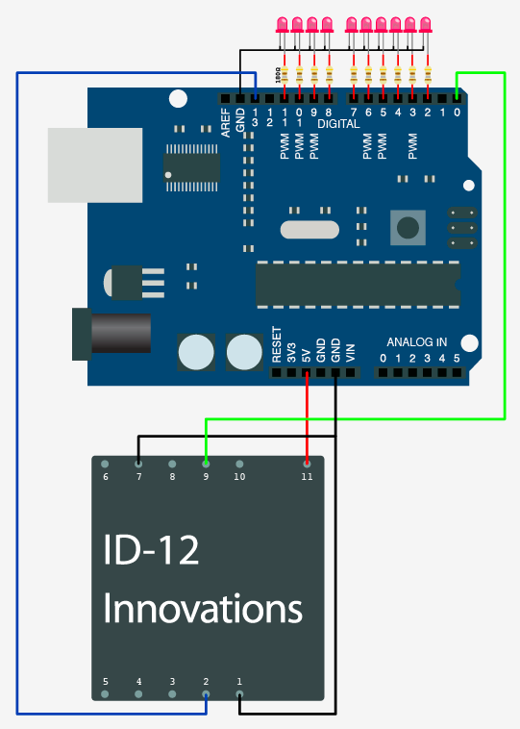
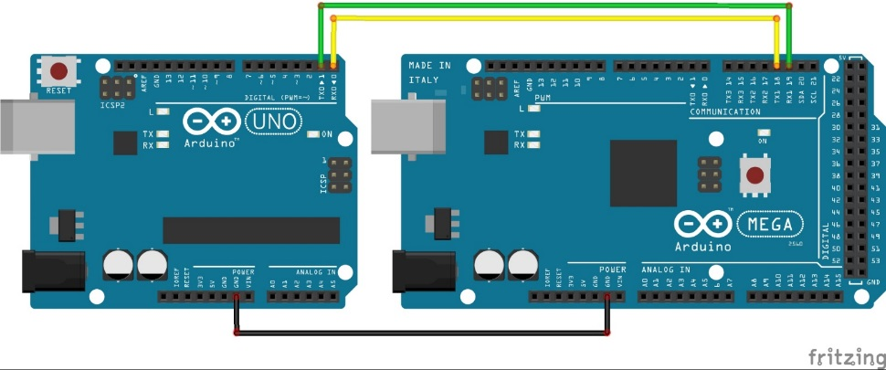
Connecting devices with Serial
Connect multiple arduinos
Interface with some sensors (e.g. RFID)
Connections are exclusive, so need separate port for each connection
MEGA/DUE have 4 hardware serial ports
Can use softwareSerial on other digital pins (but some limitations)
Serial RFID reader

Slide 9
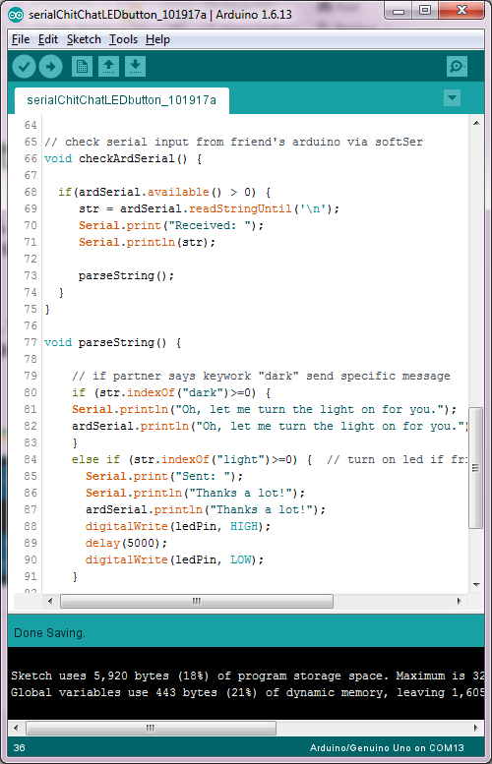

Exercise: chit-chat with Serial
Use SoftwareSerial library to enable two serial connections with your UNO
Find someone next to you, connect your TX with their RX and vice versa (pin 8/9 with softSerial)
Open serialMonitor, type messages and send to your Arduino, which are echoed to partner’s Arduino
Parse incoming serial text, send output back depending upon input and turn on LED
If you send a message including the word “dark”, your partner’s Arduino will send back a message containing “light” which will turn on your LED for 5sec

Slide 10
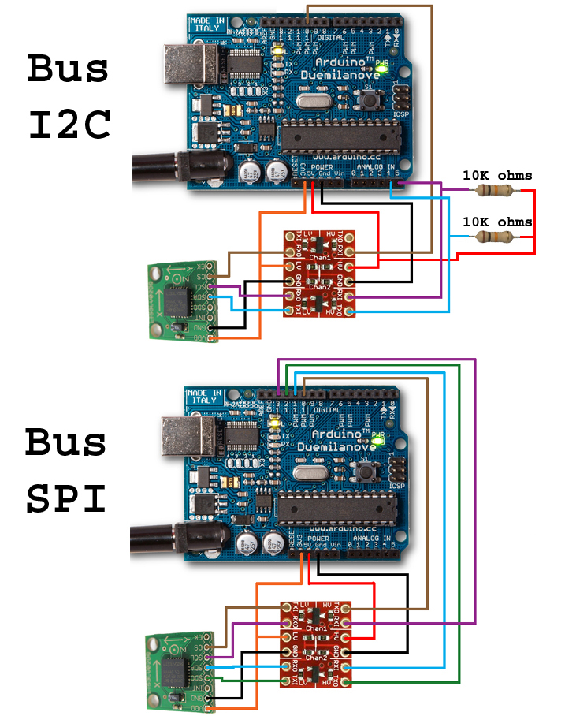
Talking to other chips: I2C and SPI
Talk to lots of digital sensor and control chips using same interface
Use same input pins (e.g. SDA:data, SCL:clock) to attach multiple devices
Uses device addressing
Control component behavior and get/set input/output (set registers)
Uses Wire library

Slide 11
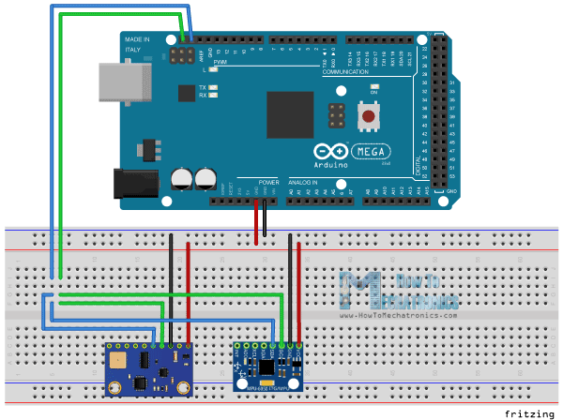
Connecting multiple devices with I2C
Many devices can use the same 2 wires (SDA,SCL) for I2C communication
Each must have a different address

Slide 12

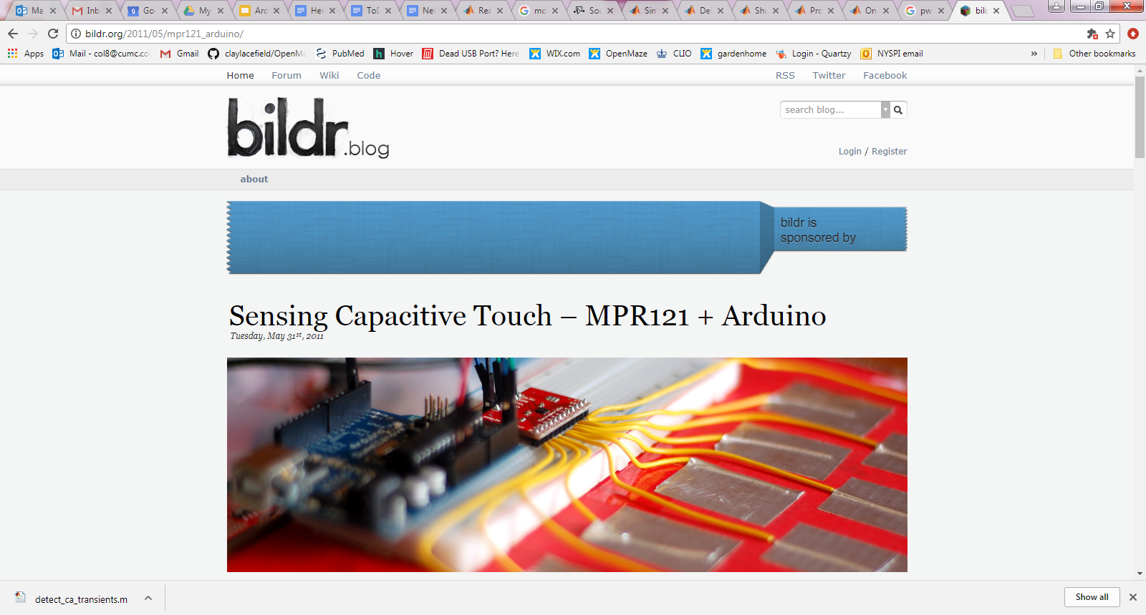
I2C commun. with MPR121 capacitive touch sensor
We will use this for our last exercise today to detect “mouse licks”…

Slide 13
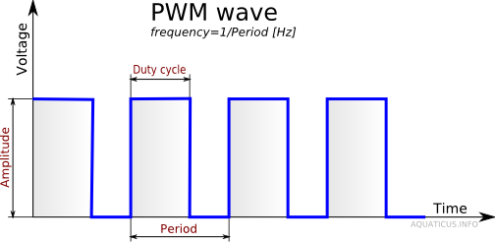
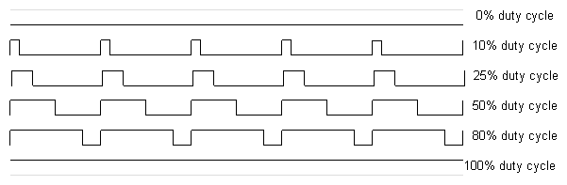

Analog Output (PWM, tone)
Analog output?
PWM: pulse-width modulation
analogWrite(pwmPin, dutyCycle0-255);
Approximates an analog signal with a digital output

Slide 14
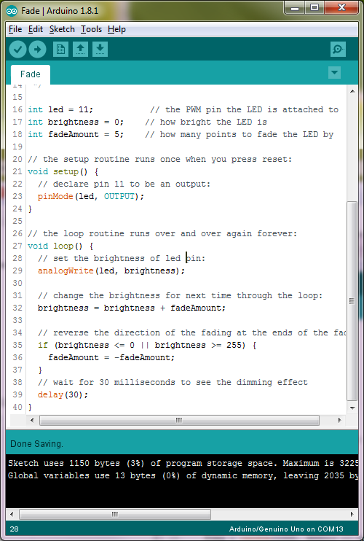
Fade
Use PWM with analogWrite(pwmPin, dutyCycle); to control the brightness of an LED
Plug LED into PWM (“~”) pin (e.g. pin 11)

Slide 15
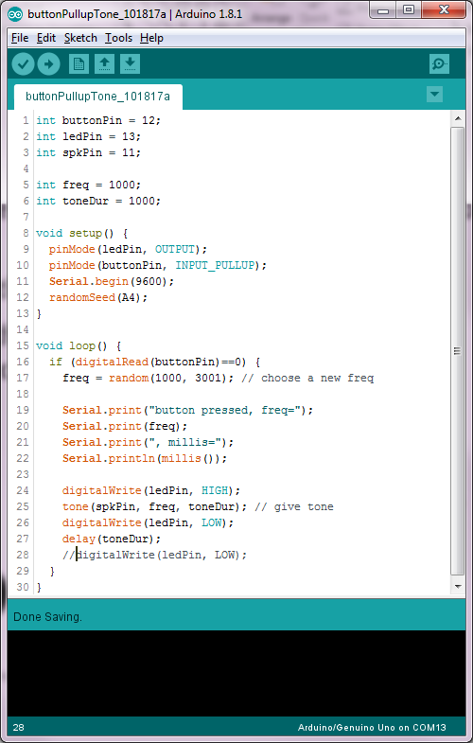
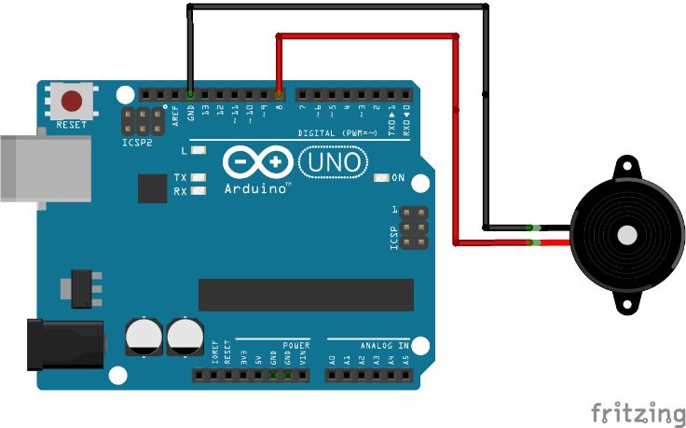
Tone
Arduino code:
buttonPullupTone_101817a.ino
tone(pin, freq, dur); uses a built-in timer to deliver a sound on a digital pin (PWM not nec.)
“Non-blocking”: other things can take place during tone
NOTE: can interfere with other libraries that use the same timer (e.g. servo), especially on UNO.
Can also use tone to deliver pulse trains (e.g. for LEDs)

Slide 16

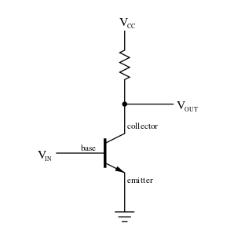

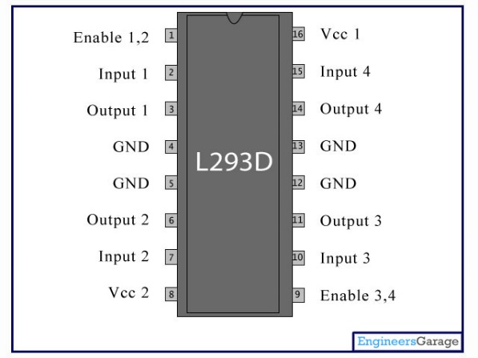
Digital outputs
Getting around the 0/+5V limitation
Relays
Transistors
H-bridges

Slide 17

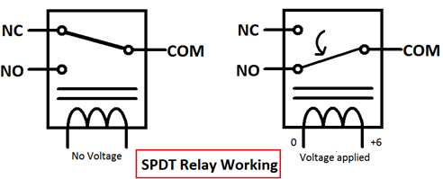
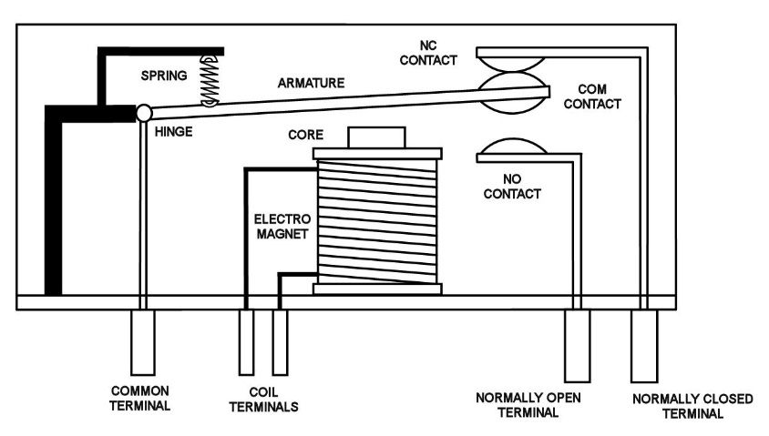
Relays
An electromechanical switch
Can carry DC or AC
Loud and relatively slow (compared to transistors)
Put negative-biased diode across inputs to prevent inductive feedback from coil
Current limit: LARGE (up to 10A)
Notes:
Demo arduino relay extension cord

Slide 18
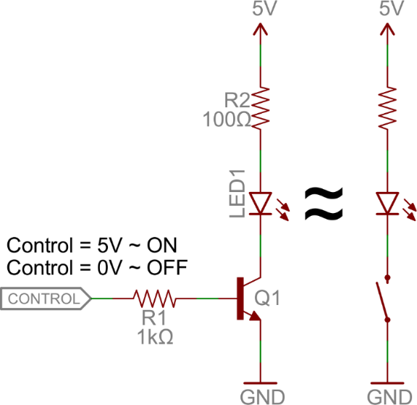
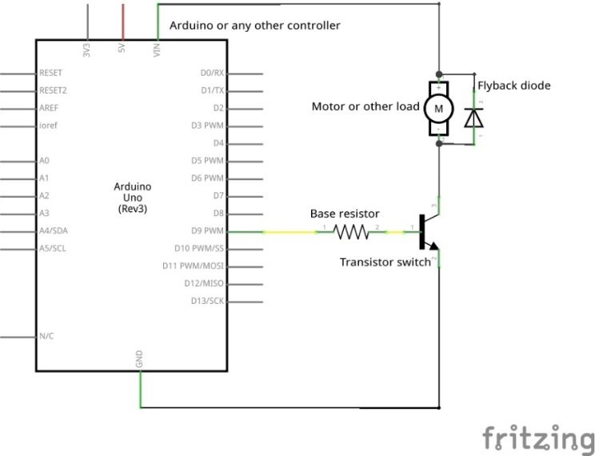
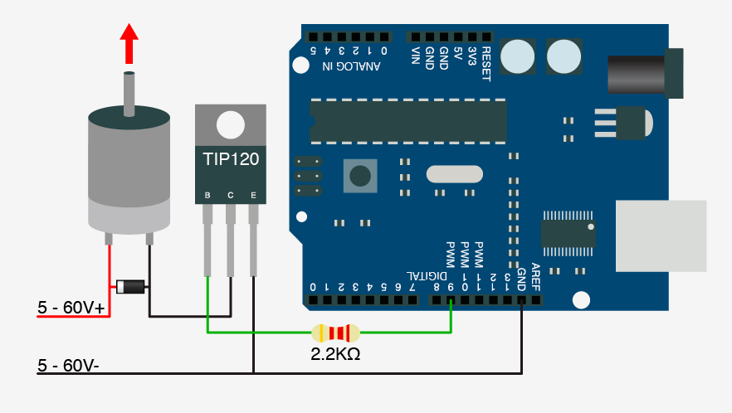
Transistors
Basically a voltage-gated switch
Very fast (e.g. can PWM), and silent
Still can’t do negative Vs
NPN vs. PNP
Current gain β
50mA Arduino digital current may not be able to switch big current loads
Notes:
For PNP, you ground the base to activate.

Slide 19
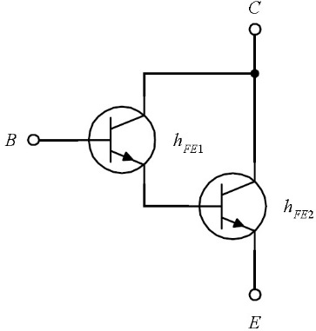
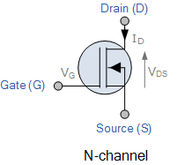
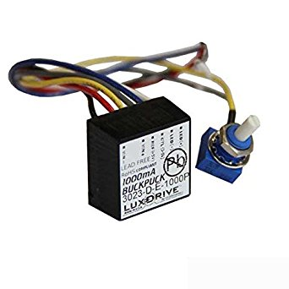
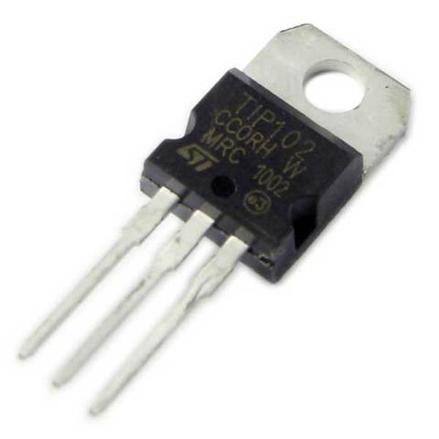
Tricks for high current loads
For a normal BJT, beta = 50-200
Arduino digital outputs = 50mA
Thus Arduino can drive a transistor to saturation with 2.5-10A loads
Thus use Darlington pair or MOSFET (or “buckpuck” for LEDs)
Darlington pair
MOSFET
Buckpuck (~$15)

Slide 20
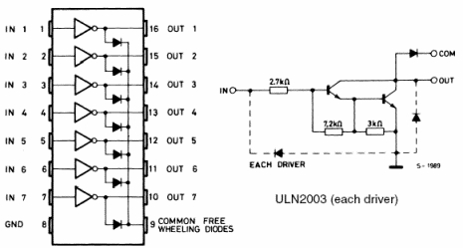
Transistor arrays
ICs like the ULN2003/2803 array provide 7/8 darlington pair gates for a Vcc supply voltage.
Can therefore control many solenoid valves or up to two unipolar stepper motors.
But still can only carry current in one direction.
Current limit: ~1A/channel

Slide 21
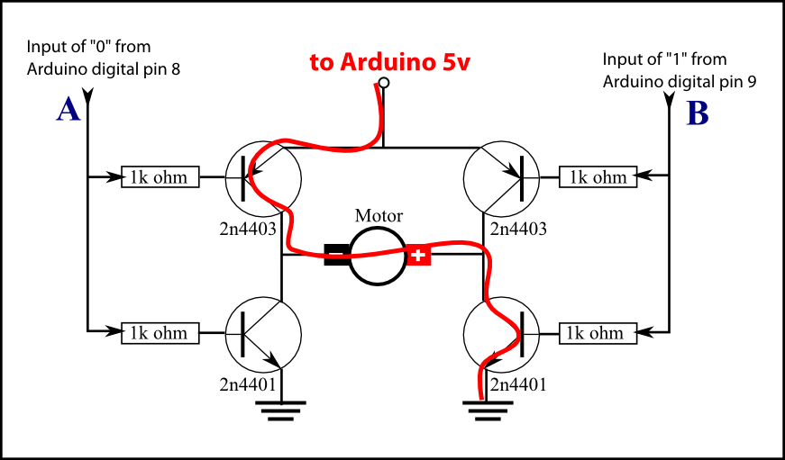
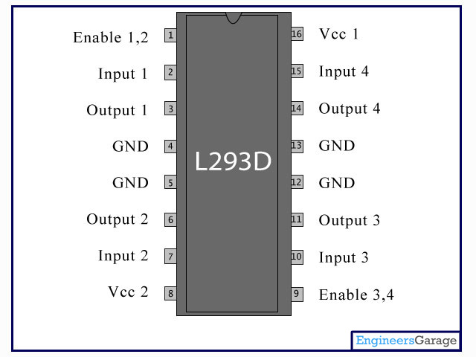
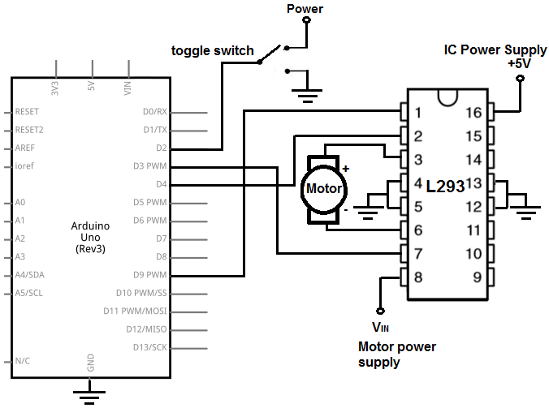
H-bridges
H-bridges are transistor arrays that allow you to apply a larger supply voltage, AND + or –
This makes it one of the single most useful components for controlling diverse devices
Current limit: ~1A/channel

Slide 22
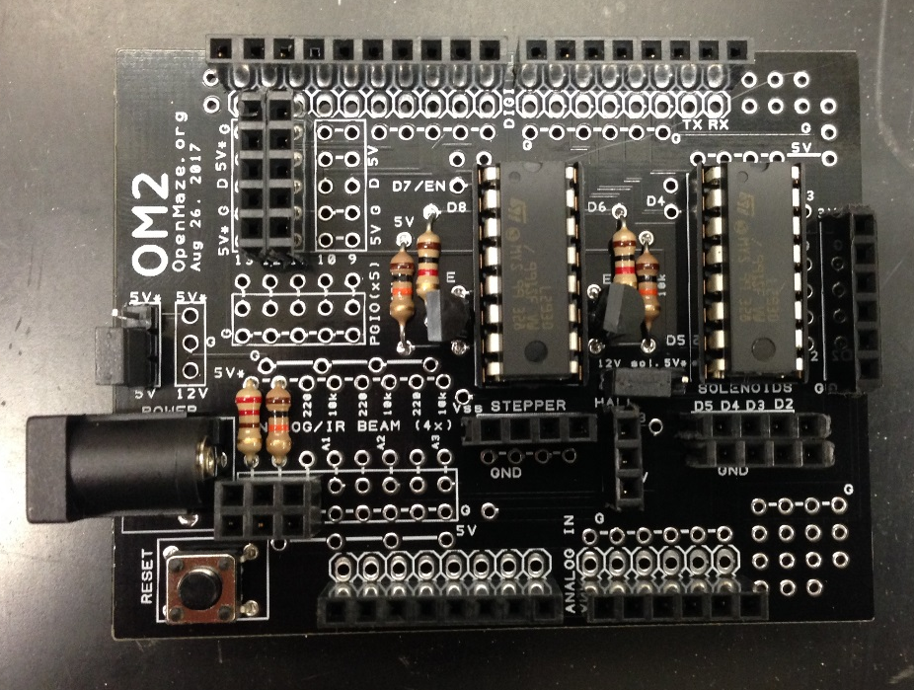
OM2 shield
Your OM2 board (named so because it has 2 H-bridges), has one H-bridge with 2-wire control for controlling one bipolar stepper, and one H-bridge that can independently control 4 solenoid valves, DC motors, etc.
Stepper/DC motor
Sol. Valve (12/5V, x4)
Notes:
Using this shield will allow us to try out a wide range of different devices without spending time on wiring.

Slide 23
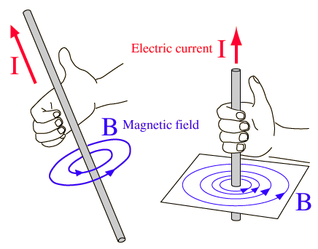
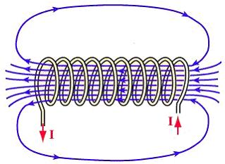

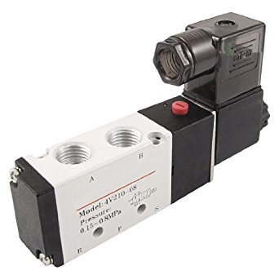
Solenoids (esp. solenoid valves)
Solenoid valves are useful for a variety of functions
Liquid reward
Airpuff punishment
Olfactory stimuli

Slide 24
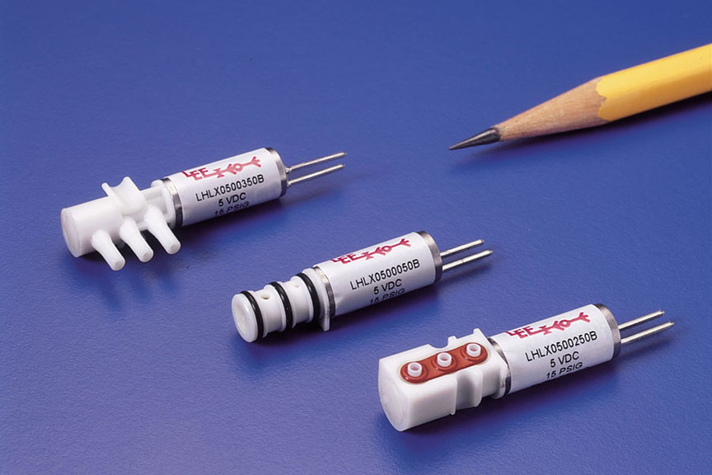
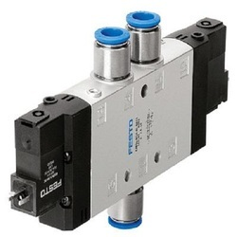
Types of solenoid valves
Liquid (Parker, Lee Co.)
Liquid or pneumatic (air)
2 way/ 3 way
5V (Lee)/12V/24V
Latching / non-latching
Pneumatic (Festo, SMI, Amazon)

Slide 25
Exercise: MPR121 touch sensing
Use Bildr code to read touch inputs with MPR121
MPR121 touch sensor (I2C, x12)

Slide 26
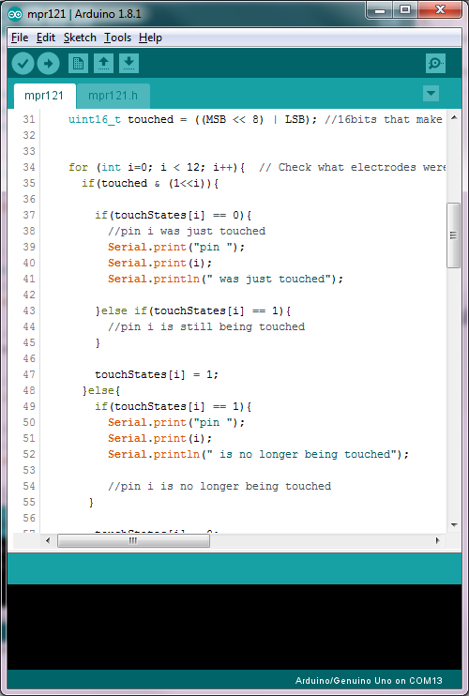

Exercise: give water droplet upon touch input
Modify Bildr MPR121 code to open solenoid valves for a short time when touch port is activated.
MPR121 touch sensor (I2C)
+12V
Sol. valve

